Slide 1
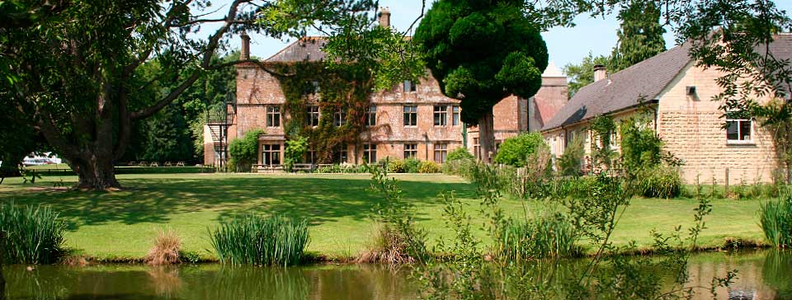
Year 5 Residential
Hooke Court May 2026

Slide 2
More about Hooke Court
Located just 11 miles from the Jurassic Coast, in the small village of Hooke in rural West Dorset, Hooke Court is a magnificent setting in which to stimulate and educate children.
Grade II listed 14th century manor house
Stunning historical, rural location that brings learning to life
Twenty-four acres of landscaped grounds and woodlands
Playground, playing fields and low ropes course
All groups are fully catered for and accommodated in their own area
https://www.hookecourt.co.uk/residential/

Slide 3
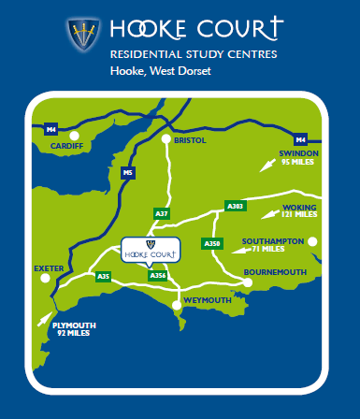

Slide 4
Staff
Ms Sharp (first aid)
Ms Hatley-Smith
Miss Nicky (first aid)
Mr Will Annat

Slide 5
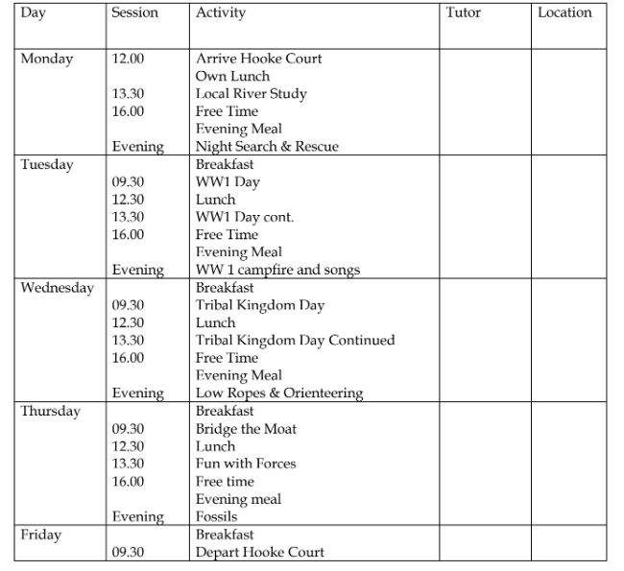
What we will do…

Slide 6
When packing…
Packed Lunch
Please pack a lunch for the first day, including a reusable water bottle, which the children will need for the week.
Bags and Tags
Please clearly mark all belongings with names and also the entire luggage with a label showing student name and school name. Children will need to be able to carry their own luggage from the coach to their accommodation.
Money
There will be no opportunity to spend money at Hooke Court as there is no shop. Please do not send money along with your child.
Sweets and Treats
We will be providing these for the children, so please do not pop any in their luggage!

Slide 7
Kit List
Clothing and shoes worn outside during activities will inevitably get dirty – so old clothes are best! We try to help children look after their things, but items regularly get lost or left behind.
We therefore strongly recommend that you name all items of clothing – it works best if you supervise your child packing their own bag and then provide them with a packing list, so that they can check items back into their bag.
Please use the following checklist to help pack bags:
Sleeping bag or duvet & cover; pillow case
Toiletries bag containing: toothbrush, toothpaste, soap, flannel, deodorant (no aerosols), hairbrush etc
Towels (hand towel and shower towel)
Night clothes (pyjamas are recommended rather than nighties)
Cuddly toy
Socks and underwear (with several spare pairs)
T-shirts, shirts (at least 2 with long-sleeves* and a couple of spares)
A couple of thick sweaters or sweat-shirt/ lighter sweater for inside
Trousers, leggings, tracksuit bottoms, shorts (with a couple of spares). No jeans!
Waterproof jacket with hood - ABSOLUTELY ESSENTIAL! (waterproof trousers if you have them)
Welly boots – ABSOLUTELY ESSENTIAL! Please also make sure they are full length and not ankle wellingtons
2 Pairs of trainers (not best ones!) or walking boots
Indoor shoes/slippers/sliders - ESSENTIAL
Torch
Large plastic bag for dirty clothes
Sun hat and sun-cream
Book/small portable game (cards, uno….) Reusable water bottle Lunch for Day One
Disposable camera
Book/small portable game (cards, uno….)
Reusable water bottle
Lunch for Day One
Please note that outdoor activities require long sleeves and long trousers even in the summer to protect legs and arms from scratches, ticks etc.

Slide 8

Items children should not bring
Please do not send mobile phones, expensive cameras, electronic games, iPods, Kindles, expensive or much-cherished jewellery, expensive or favourite clothing or shoes. All accommodation is locked securely but we cannot be responsible for any loss or damage to personal property.

Slide 9
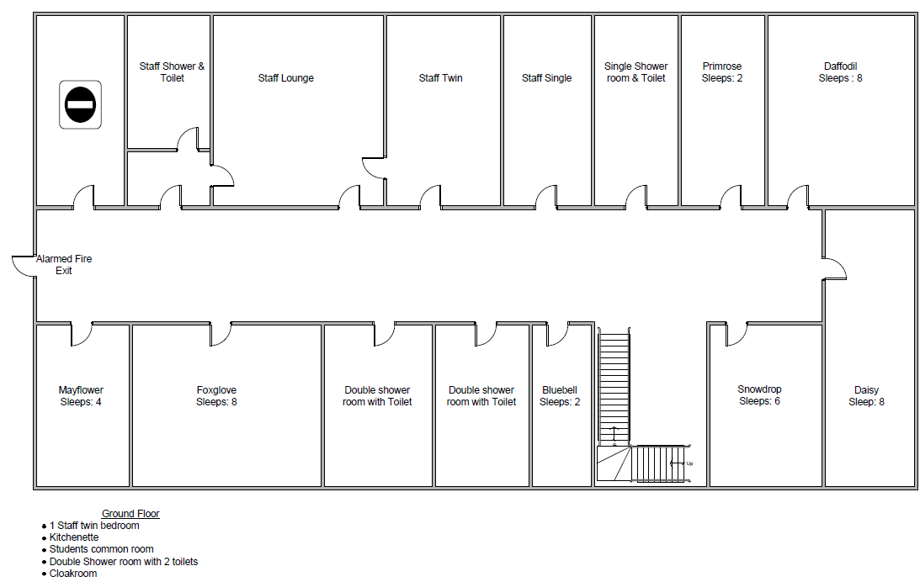
Accommodation
We will be staying in our own separate accommodation block.
.
The week before we go, children will be asked to name 2 children (same gender) for preferred roomies – I will guarantee at least one of these! They will not find out their rooms until we are on the coach.

Slide 10
Key Info - Departure
Monday 18th May 2026
The coach will leave school at 8.30 a.m. and therefore children must be at school by 8.00am to allow for toilet runs and for luggage to be loaded.
All medication to be handed to Miss Nicky in a named bag, with all relevant instructions.
Parents are welcome to wait on the Common to wave their child off as we depart.

Slide 11
Key Info - Return
Friday 22nd May 2026
We will come home via Westbay (Broadchurch!!) where we will stop for a beach walk and a chance to explore the Jurassic Coast. We aim to leave there after our picnic lunch at 12.15pm.
It is a three hour journey, but as always we will be at the mercy of traffic. We will be in constant touch with school, who will in turn keep you updated with the ETA.
Expect us back at around 15.30/16.00.

Slide 12
Key Info - Medication
All medication, including travel sickness pills, over-the-counter hayfever pills etc. must be brought to school in a small, labelled plastic bag and given to Miss Nicky, together with any instructions required. Please make sure all medication is in date.
For travel sickness, please administer medication to your child on the morning of departure and we will do the same on the morning we leave to come home.

Slide 13
Key Info - Emergencies
During school hours, please phone the office at All Saints’ and they will contact one of us.
We will advise you of an emergency number to contact us on outside of school hours but we must stress that this is for emergencies only, not for updates on your children.
We will email school daily with an update of what the children have been doing – this will be parent-mailed to you.

Slide 14
Information for you to complete
Please ensure that all forms are handed back by tomorrow morning, please
.
The forms that need to come back to us are:
Medical and Dietary form (crucial – we will cross-check with information on file in school)
Code of Conduct
The due date is tomorrow!

Slide 15

Questions?

